Slide 1
PDAS CA2 - How does number of graduates in Singapore contribute towards employment rates and job vacancies?
Name: ivan tay yuen heng
Class: daaa/ft/1b/03

Slide 2
Datasets URLs
Graduate Employment Survey - NTU, NUS, SIT, SMU, SUSS & SUTD
https://beta.data.gov.sg/datasets/d_3c55210de27fcccda2ed0c63fdd2b352/view
Graduates by institutions
https://beta.data.gov.sg/datasets/d_06067a3d18f8a5779acfbf19c62cb656/view
Employment Rate of Residents Aged 25 to 64 (Total)
https://beta.data.gov.sg/datasets/d_f50492fe89a0c3a522bf9c04ce3e6380/view
Job Vacancies – Topline
https://beta.data.gov.sg/datasets/d_69d444ac676644d33bf4010de19c95a5/view
Job Vacancy Rate - Topline
https://beta.data.gov.sg/datasets/d_cbe1d2c4e90562e78ec821f39e05e94a/view

Slide 3
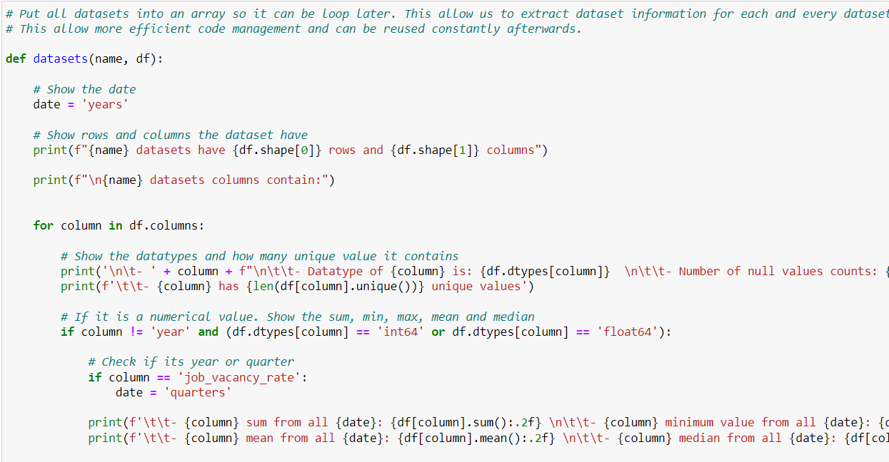
Dataset function for reusability and efficiency
I use a dataset function so it allow me to extract information for all datasets, allowing more efficient code management and can be reused constantly afterwards
The function will print out any dataset rows and columns using df.shape
Prints out any column datatypes using df.dtypes[column], total count of null value in specified column using df[column].isnull().sum().
If there is a numerical value, it will print out specified columns.
column sum using df[column].sum():.2f
column minimum using df[column].min():.2f
column maximum using df[column].max():.2f
column mean using df[column].mean():.2f
column median using df[column].median():.2f

Slide 4
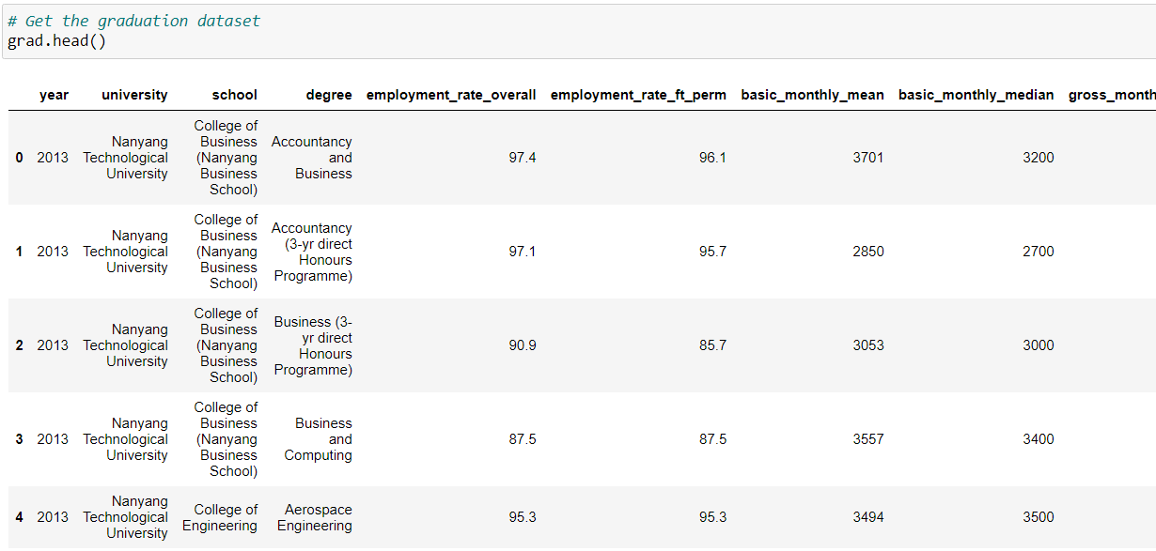
Data analysis – Graduate Employment survey
We will first examine the graduation employment survey. Our first objective is to see which university offers the highest overall employment rate and full-time permanent employment rate.
Collect the graduation employment survey dataset.

Slide 5
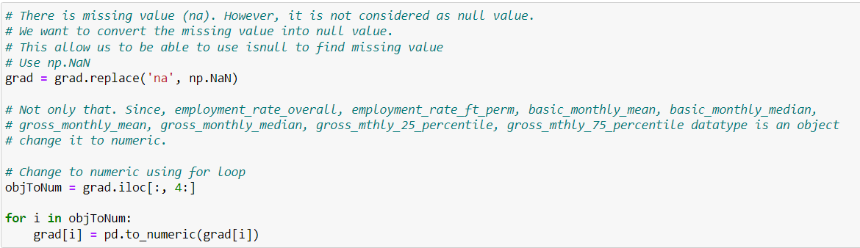
Format the dataset correctly for later
There is missing value (na). However, it is not considered as null value. We want to convert the missing value into a null value. This allow us to be able to use isnull to find missing value. Use np.NaN
Some columns are object and should be numeric, change it to numeric using pd.to_numeric

Slide 6
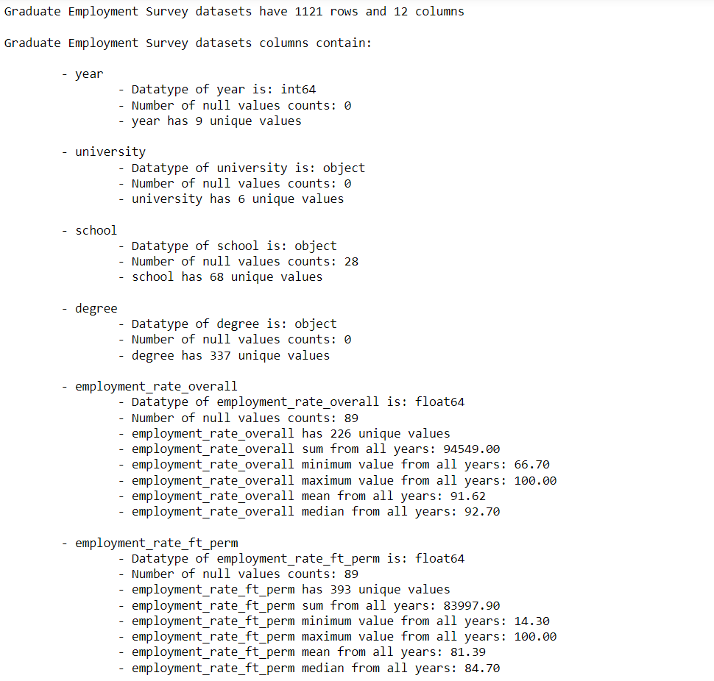
Graduate Employment Survey
Graduate Employment Survey dataset have twelve columns consist of year, university, school, degree, employment_rate_overall, employment_rate_ft_perm, basic_monthly_mean, basic_monthly_median, gross_monthly_mean, gross_monthly_median, gross_mthly_25_percentile and gross_mthly_75_percentile.
university columns have 6 unique value and 0 null value.
schools columns have 68 unique value and 28 null value.
degree columns have 337 unique values and 0 null value.
The remaining columns have a total of 89 null values each.
Most important columns that we need to get: (employment_rate_overall and employment_rate_ft_perm)
employment_rate_overall have a sum rate of 94549%. The least employment_rate_overall rate is 66.70%. The most employment_rate_overall rate is 100.0% rate. employment_rate_overall have a higher median rate than its mean rate since it has a mean of 91.62% and median of 92.70%. It has 226 unique values.
employment_rate_ft_perm have a sum rate of 83997.90%. The least employment_rate_overall rate is 14.30%. The most employment_rate_overall rate is 100.0% rate. employment_rate_overall have a higher mean rate than its median rate since it has a mean of 81.39% and median of 84.70%. It has 393 unique values.

Slide 7
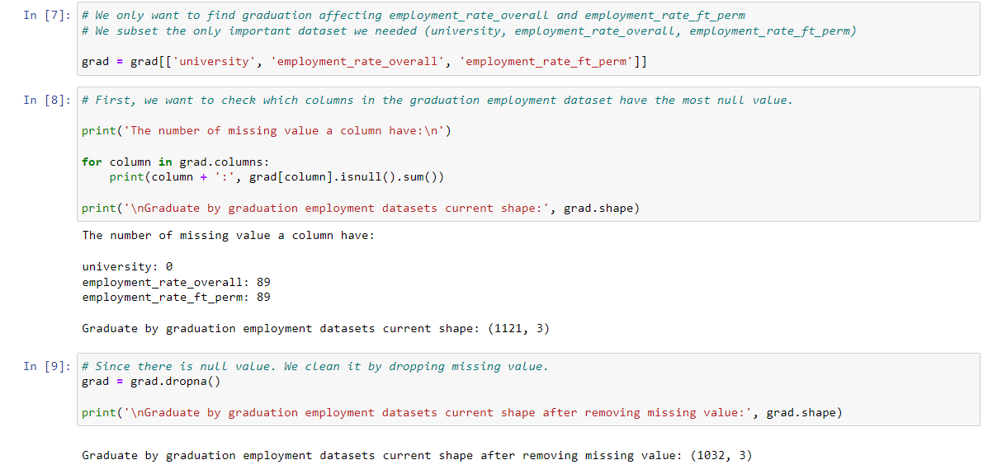
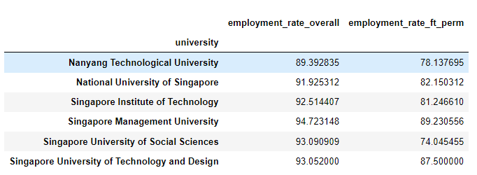
Find mean employment
- Subset the important part only and find the null value.
- Then, deal with the missing value by dropping it.
- Find the mean for overall employment rate and full time permanent employment rate for each institution using .groupby

Slide 8
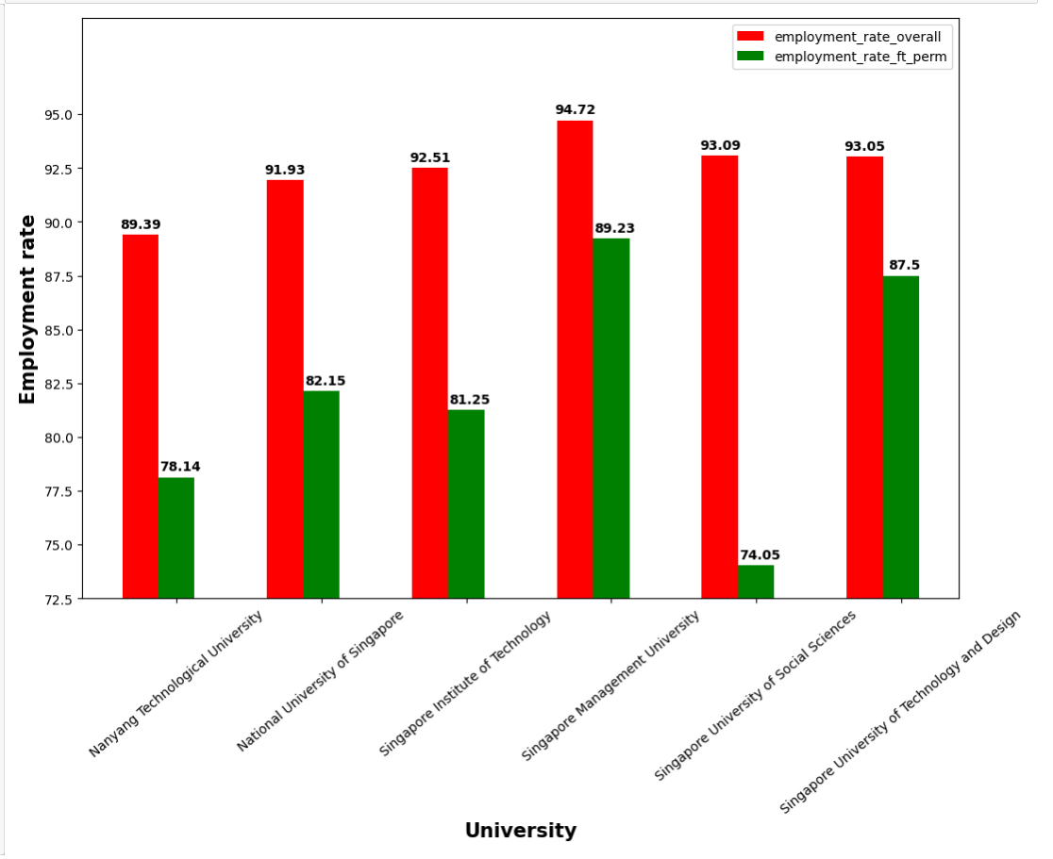
Bar graph
From the bar graph, we can see that Singapore Institute of Technology have the highest overall mean employment rate of 94.72% and the highest mean full time permanent employment rate of 89.23%. Even though Singapore University of Social Sciences have the second highest mean overall employment rate of 93.09%, it apparantly has the lowest mean full time permanent employment rate of only 74.05%. Lastly, Nanyang Technological University have the lowest overall mean employment rate of only 89.39%.
Overall, graduating from institution in Singapore does allow a higher rate of employment entry (>70%). However, how does it affect employment rate in general?
Now, we want to see whether number of graduates does affect employment rate and job vacancies

Slide 9
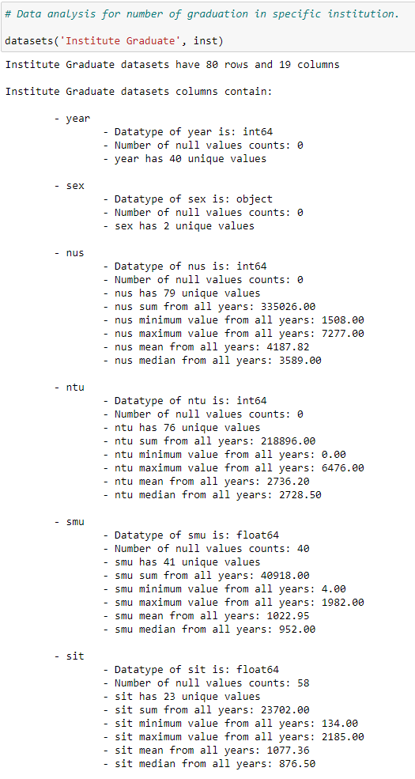
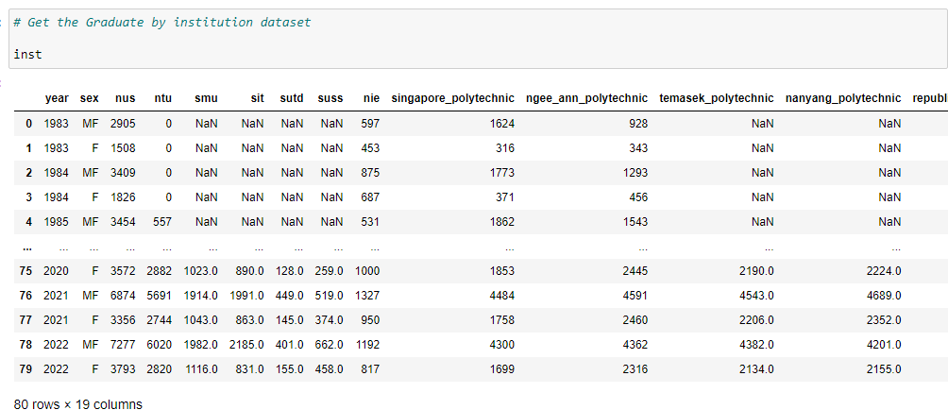
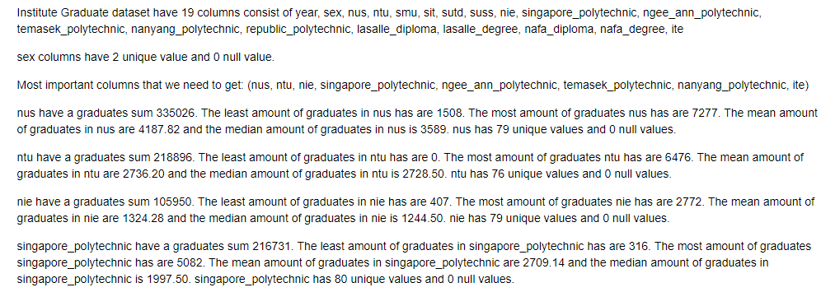
Number of graduation per institution
Get the institution datasets because we need to find the number of graduates for every institution
Analysis the data using the datasets function
Information could be found below the data analysis for number of graduation in specific institution
Example →

Slide 10
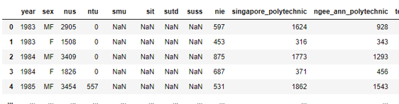

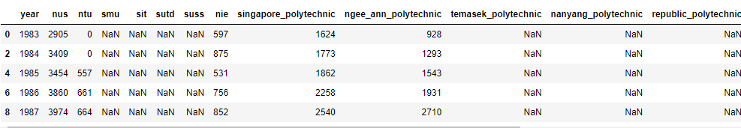
Remove sex (gender) column
Subset the datasets rows to only have rows containing MF (Male and Female) in sex columns.
Since F is only consist of one gender and we would like to find the total number of people with both gender that graduate the institute instead.
Afterwards, drop the 'sex' column because it is all the same value

Slide 11
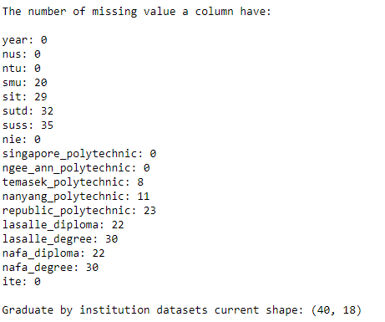
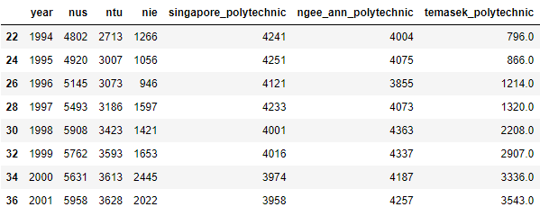
Deal with missing values
The dataset currently contains 40 rows. However, if any column has 20 or more null values, it would result in a 50% loss of data (20 rows left). Therefore, we plan to eliminate columns with 20 or more null values to preserve data integrity.
Now, drop any rows that have null values. You could not backwards fill nor forwards fill because some schools were not established before that.

Slide 12
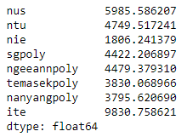
Pie chart preperation
We want to find the mean for graduation for each institution to plot a pie chart seeing which institution have the highest percentage of graduation.
Use inst_pie = inst_box.mean()

Slide 13
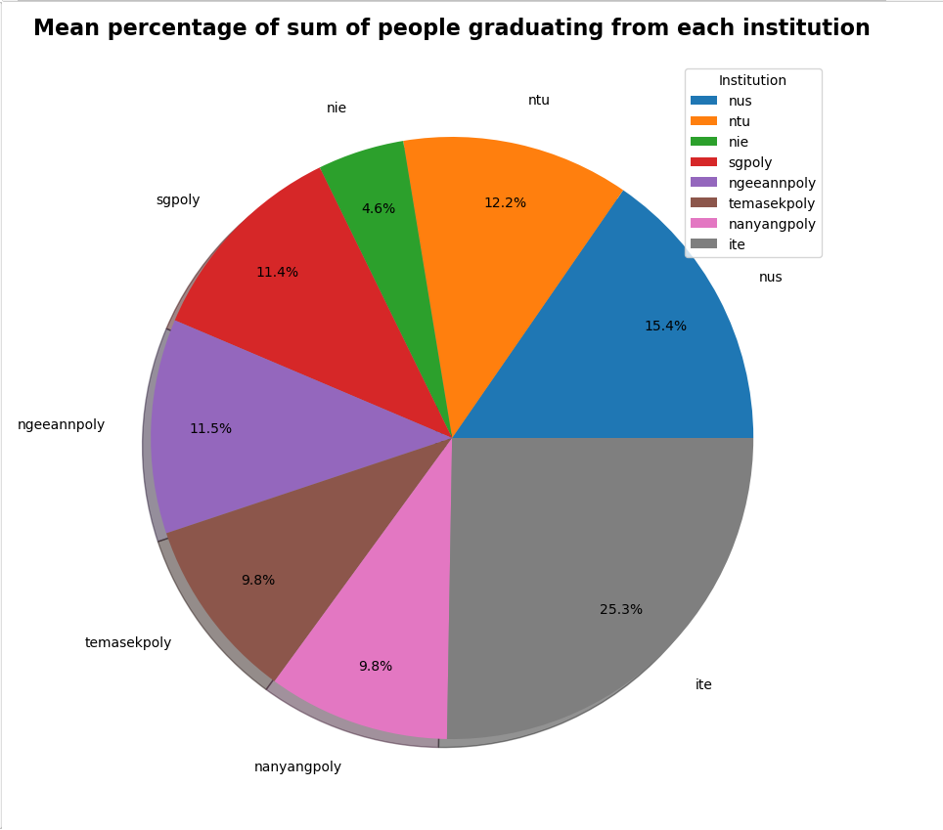
Pie chart
ITE (Institute of Technological Education) have the highest percentage of mean sum of people graduating by 25.3% compared to other institution. This highlight its huge role in educating students for success.
The second highest percentage of mean sum of people graduating by 15.4% is NUS (National University of Singapore).
In contrary, NIE (National Institute of Education) have the lowest percentage of mean sum of people graduating by only 4.6%.

Slide 14
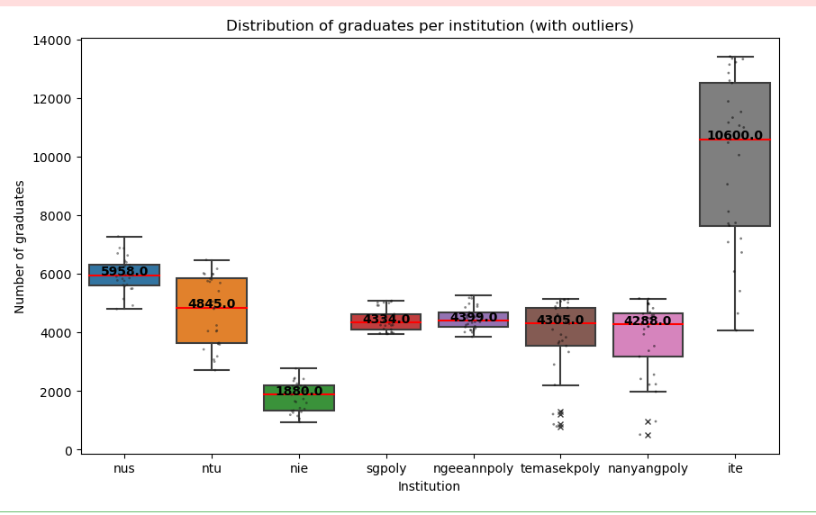

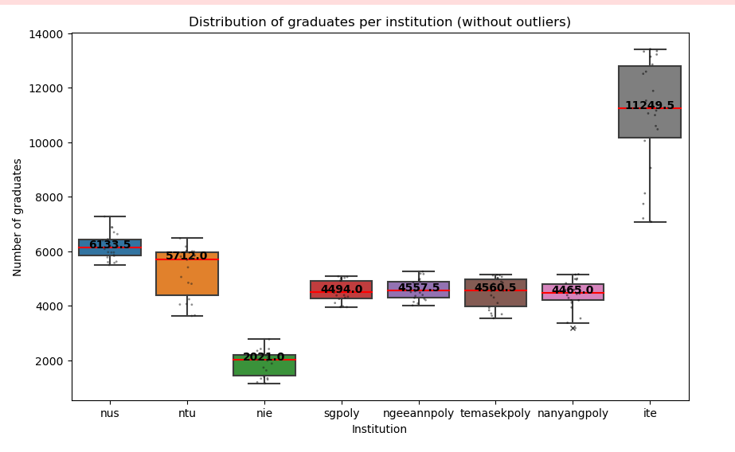
Box plot with outliers
Now make a box plot to find any outliers in sns. This is to ensure linear regression have a better fit for later on.
There is outliers for temasek polytechnic and nanyang polytechnic. Now we want to remove the outliers for a more consistent dataset which can be use to find the correlation with unemployment and job vancancies later.
Not only that, ITE have the highest variaibility which shows its lack of when it comes to number of graduates in Singapore in that institute over the years. However, sgpoly (Singapore Polytechnic) have the lowest variaibility based on its box plot showing that it is more consistent or have a more fixed pattern when it comes to number of graduates in Singapore in that institution over the years.
In Figure B, the outliers are removed for temasek polytechnic and nanyang polytechnic. Since outliers are removed, new IQR is formed for nanyangpoly and one outlier was presented. Since it is relatively closed to the box plot, the outlier could be ignored.

Slide 15
Dependent variable
Now we want to get employment rate, job vacancies datasets and job vacancies rate datasets which are used as a dependent variable for number of graduation late on.
We will examine the employment rate for resident people in Singapore between age 24 to 60. Dataset is chosen because most people who graduated from an institution and finding a job will usually be above the age of 24.
EmploymentRateofResidentsAged25to64Total.csv
We want to get the number of job vacancies and job vacancies rate which both data are going to use to check the correlation of the number of graduation later on.
JobVacancyTopline.csv
JobVacancyRateTopline.csv

Slide 16
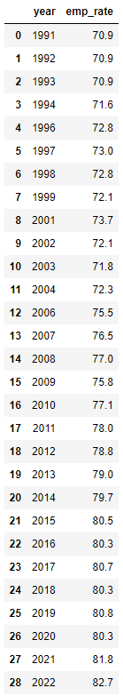
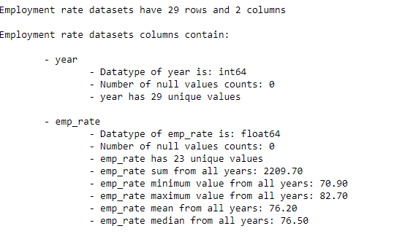
Employment rate
Employment rate have two columns consist of year and emp_rate which means the employment rate
In here, we can see that both columns have zero null values.
emp_rate have a sum of 2209.70%. The least emp_rate over the years is 70.9%. The most emp_rate over the years is 82.7%. emp_rate have a lower mean than its median since it has a mean rate of 76.2% and median rate of 72.5%

Slide 17
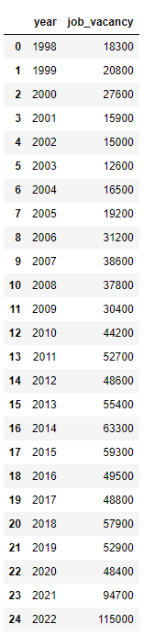
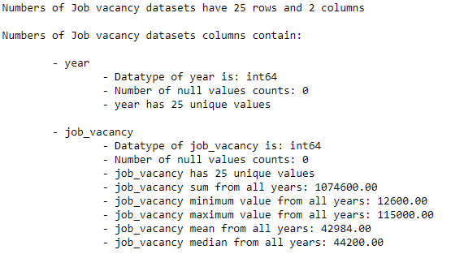
Numbers of Job Vacancy
Job vacancy have two columns consist of year and job_vacancy
In here, we can see that both columns have zero null values.
job_vacancy have a sum of 1074600. The least job_vacancy over the years is 12600. The most job_vacancy over the years is 115000.00. job_vacancy have a lower mean than its median since it has a mean of 42984.00 and median of 44200.00.

Slide 18
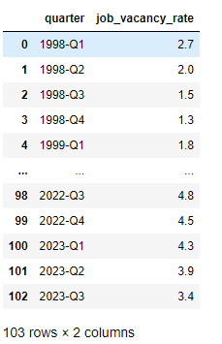
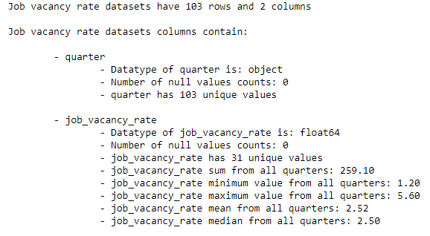
Job vacancy rate
job_vacancy_rate have two columns consist of year and job_vacancy_rate
In here, we can see that both columns have zero null values.
job_vacancy_rate have a sum of 259.10% over the quarters. The least emp_rate over the quarters is 1.2%. The most job_vacancy_rate over the quarters is 5.60%. job_vacancy_rate have a higher mean than its median since it has a mean rate of 2.52% and median rate of 2.50%

Slide 19
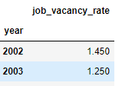
Change job_rate from quarterly to yearly
Create a new column 'year' by only getting the first 4 string (1998-Q1 --> 1998)
Use .groupby('year')['job_vacancy_rate'].mean().reset_index() to get the mean for job vacancy rate for each year
Use job_rate[4:25].set_index('year’) for concat later.

Slide 20

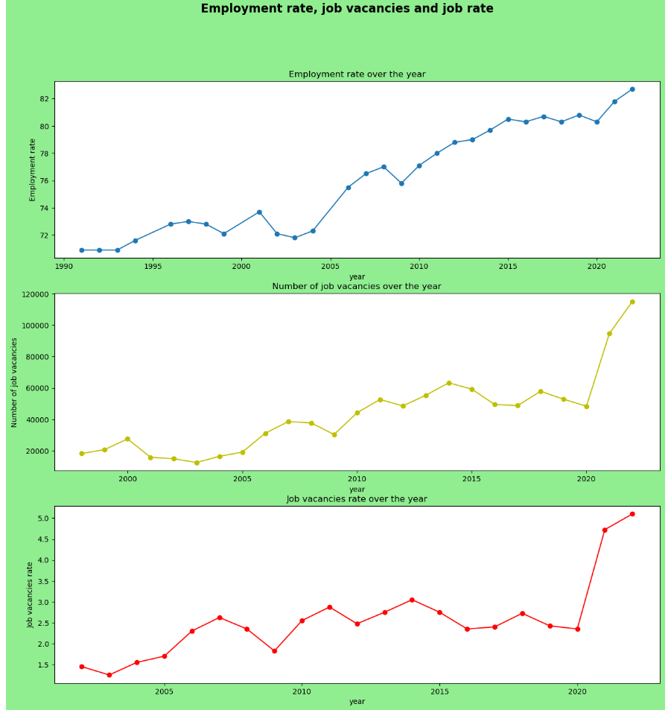
Line Graph
- Show the trend
- Employment rate, number of job vacancies and job vacancies rate over the years have been increasing over the years.
- This could be related to a higher rise in education allowing more residents to have more job opprtunities.
- Especially with a huge spike of number of job vacancies and job vacancies rate from 2020 to 2021, this might be due to other external factors such as Covid-19 recovery where more business starts to seek for more workers and business growth, increasing the rise of job vacancy rather than education.

Slide 21
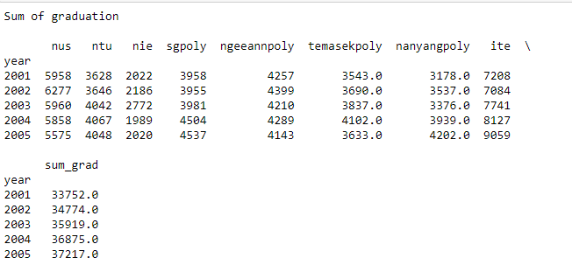
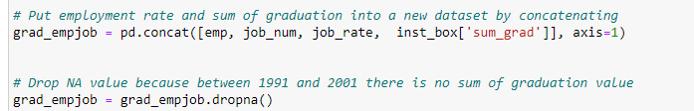
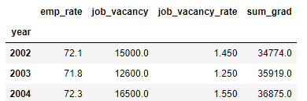
Linear Regression Preperation
We want to find the sum of all institute graduation over the years and compare it with employment rate and number of job vacancies and job vancancies rate.
inst_box['sum_grad'] = inst_box.sum(axis = 1)
Then, we want to combine all 4 columns into a dataset to use linear regression to check for data relationship.

Slide 22
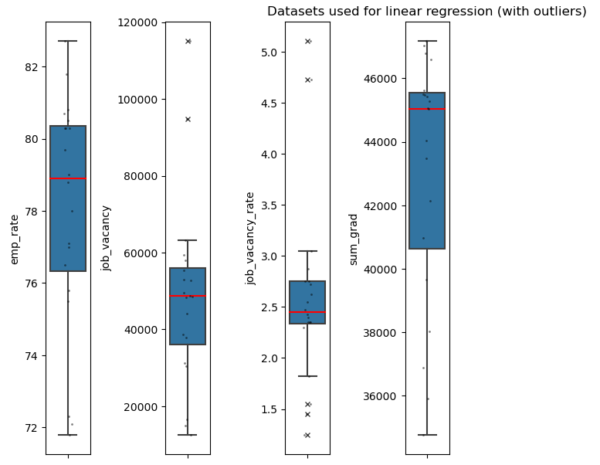

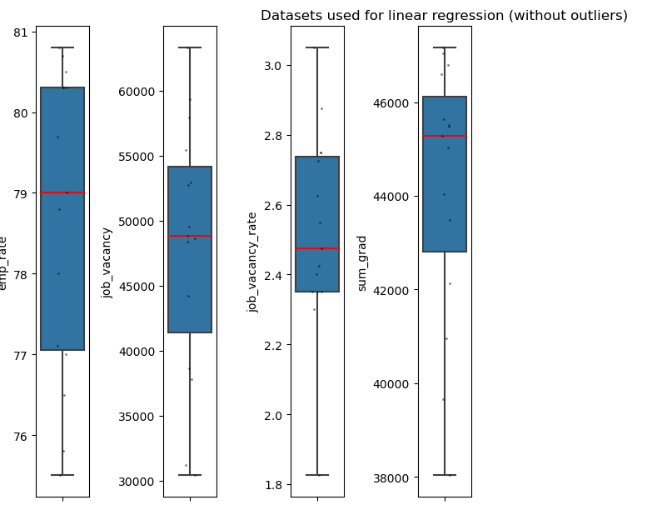
Bar Graph (outliers)
- Pre-process the data by removing outliers.
- We can see that there is outliers for job_vacancy and job_vacancy_rate. We need to remove outliers to ensure the model to have a better fit and give a better results.
- job_vacancy and job_vacancy_rate outliers have been removed

Slide 23
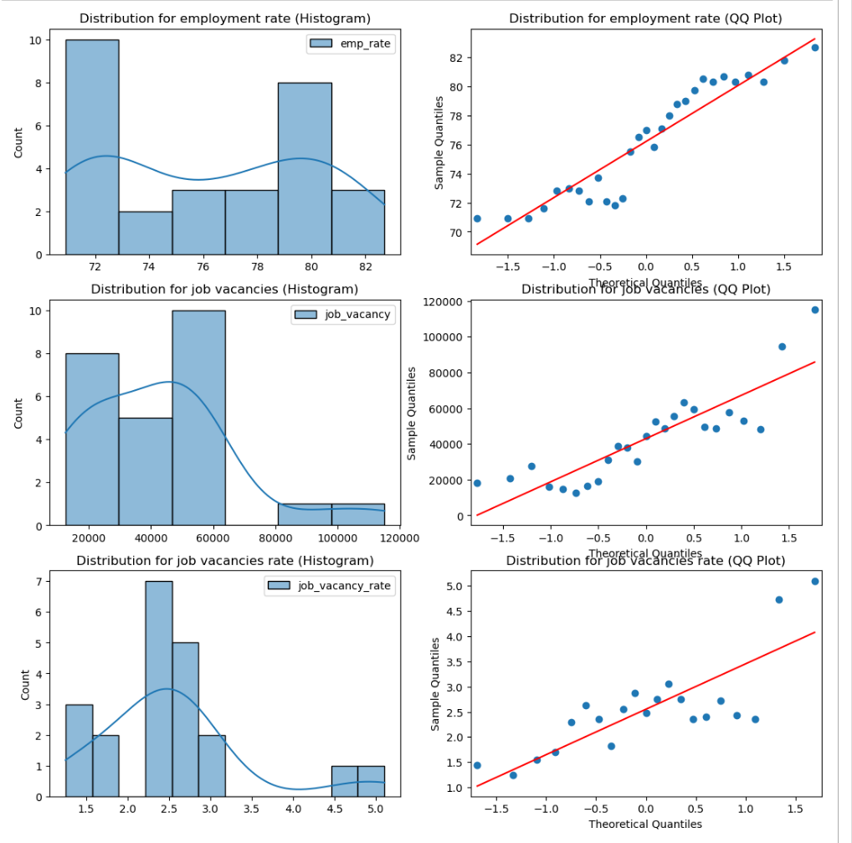
Histogram and QQ Plot
- Check the datasets distribution through Histogram and QQ Plot
- From here, we can see that employment rate have a slightly normal distribution based on the qqplot and histogram.
- This might allow data to be abit more reliable but not as reliable or accurate as a normal distribution histogram and qqplot.
- However, job vacancies and job vacancies rate does not really have a normal distribution based on both the qqplot and histogram.
- This might cause data to be a little less reliable but should not be a major factor.

Slide 24
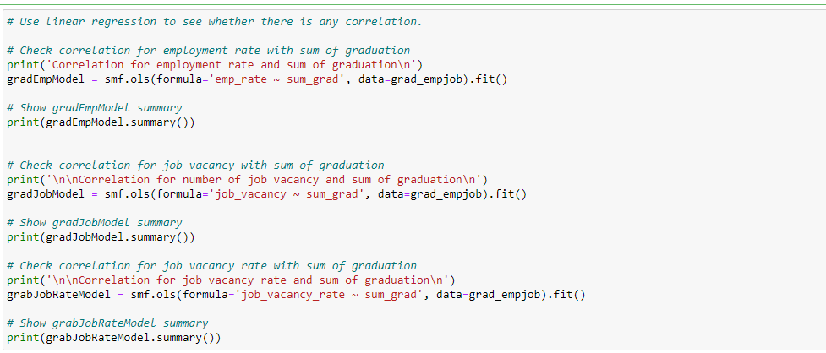
See whether there is a correlation between sum of graduation and employment rate, job vacancy, job vacancy rate using Linear Regression through statsmodels.

Slide 25
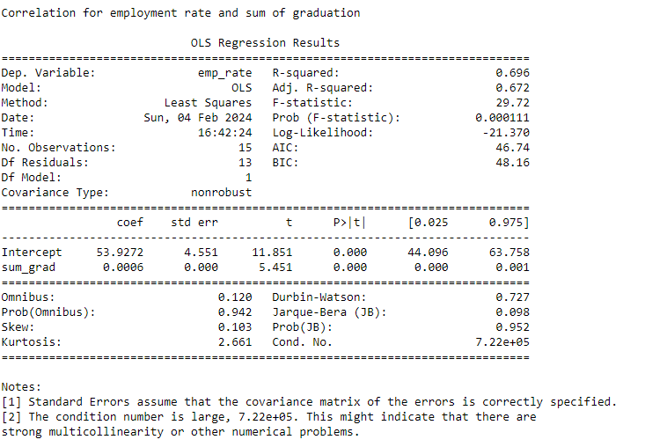
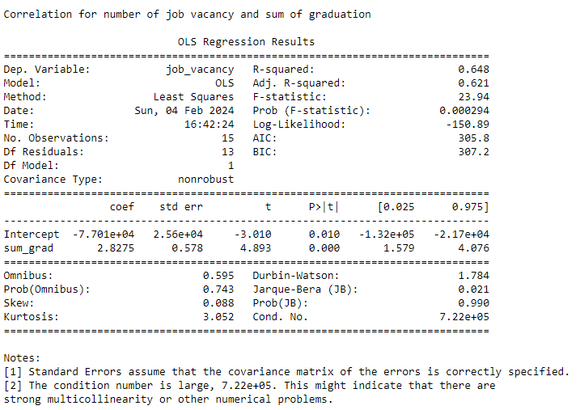
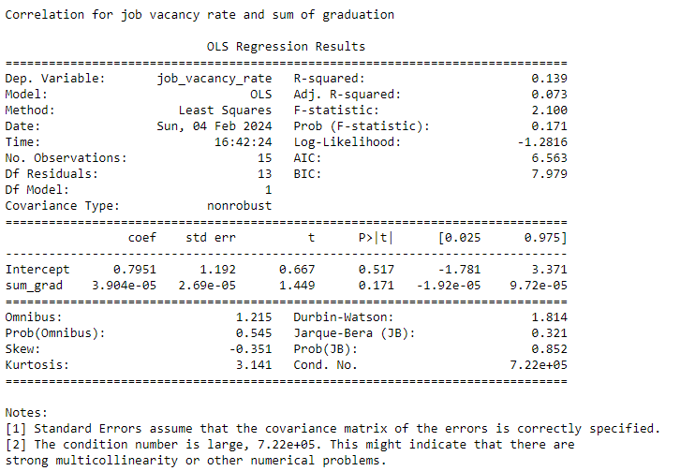
Correlation for employment rate and sum of graduation
R-square: 0.696
Correlation for number of job vacancy and sum of graduation
R-square: 0.648
Correlation for job vacancy rate and sum of graduation
R-square: 0.139
Conclusion: Sum of graduation does have a high correlation with employment rate and number of job vacancy of 0.696 and 0.648.
However, Correlation for job vacancy rate and sum of graduation have a low R-squared of 0.139. It means there is barely any correlation for sum of graduation and job vacancy rate.

Slide 26
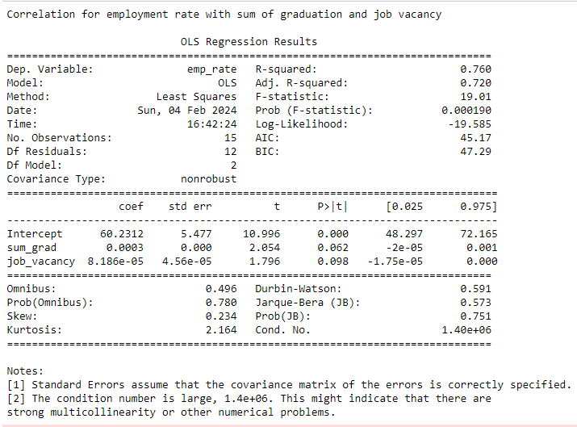
Check correlation for employment rate with sum of graduation and job vacancy
Correlation for employment rate with sum of graduation and job vacancy has an extremely high R-squared value of 0.760. This shows that when there is an increase in graduates and job vacancy, there will be likely increase in employment rate too. It can be related to how a higher labor force with a higher job position availability create more employment opportunity.

Slide 27
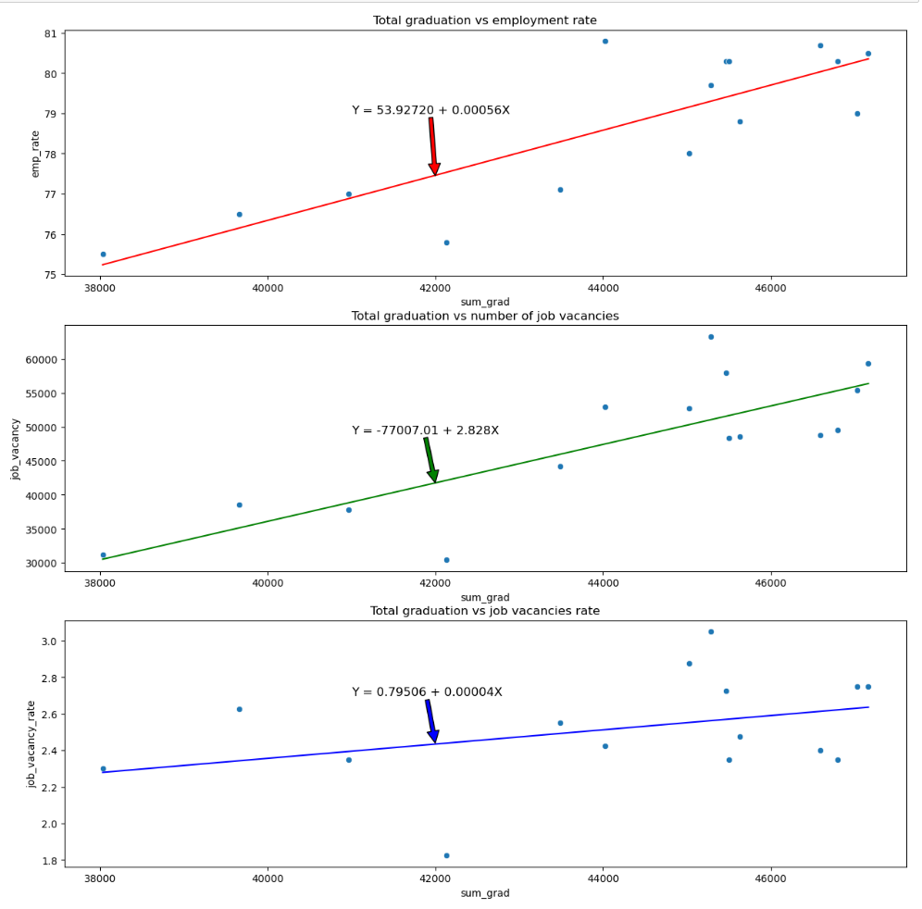
How well does the model (Linear Regression) fit the data?
Linear regression line does fit quite well in the scatter plot for all 3 graphs.
The scatter plot are quite close to the line for all 3 graphs and the linear regression line does capture the overall trend for all 3 graphs:
total graduation vs employment rate and total graduation vs job vacancies have a high positive correlation (0.696 and 0.648).
Total graduation vs job vacancies have a very low positive correlation. (0.139)

Slide 28
Conclusions
When there is an increase in the number of graduation in every Singapore institutions, the likelihood of employment rate and number of job vacancy will increase as well. The main reason was likely due to an increase in labor force since often graduates have the qualification to go for work, which incentives business to increase job vacancy to employ more workers. Thus, increasing employment rate and job vacancies.
However, increase in the number of graduation does not really affect job vacancy rate at all. This is because since job vacancies rate is the job positions availability divide to total labour force. It could mean that job vacancies may go unfulfilled due to mismatch between skills possessed by job seekers and those required by employers. Not only that, job vacancy rate can also be influenced by any other factors such as economic conditions and industry specific demand.
Additional point, there is a huge correlation in the number of graduation for Singapore institute and number of job vacancies with employment rate. This could indicates that if there is a high amount of graduates, there will be a higher labor force and with a high amount of job vacancy available, it cause an increase in employment rate.

Slide 29
THANK YOU!!!

